Slide 1
Covid-19 Update
December 13, 2022

Slide 2
Reported Covid-19 Cases in Mono County
Covid positives are massively underreported right now due to use of home antigen testing
Wastewater Surveillance Data much more useful
Some counties in CA reporting circulating Covid-19 levels equal to or higher than the Omicron surge in Jan 2022
Week of 11/13: 14
Week of 11/20: 16
Week of 11/27: 17
Week of 12/4: 13

Slide 3
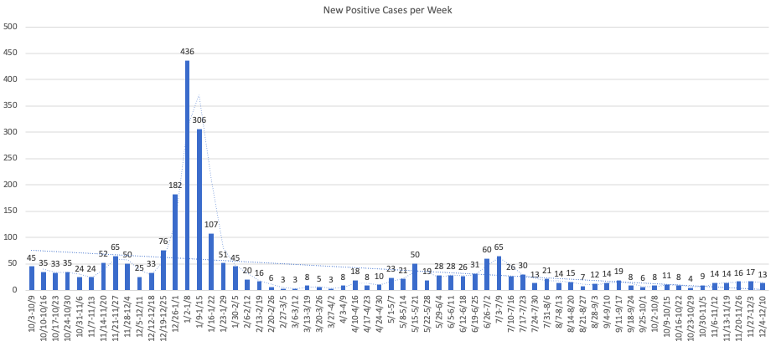
Total positive cases (PCR Conf): 3238 Positivity rate: 5.1%/ Case Rate/100,000: 13.3

Slide 4
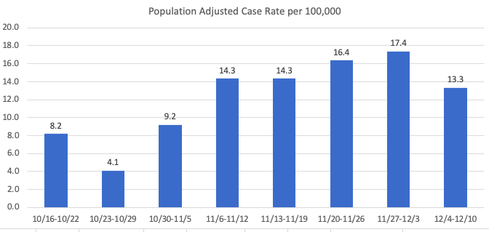
Population Adjusted Case-Rate per 100,000

Slide 5
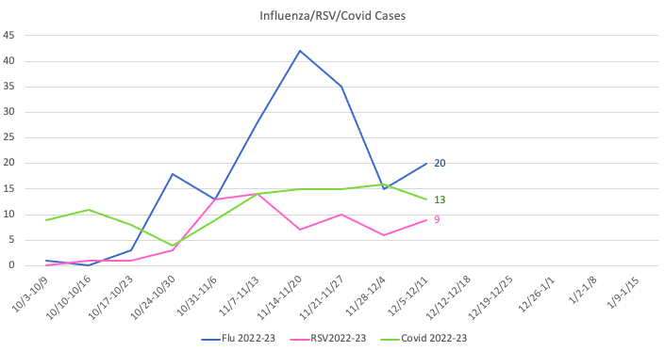
Covid-19, RSV,& Influenza in Mono County

Slide 6
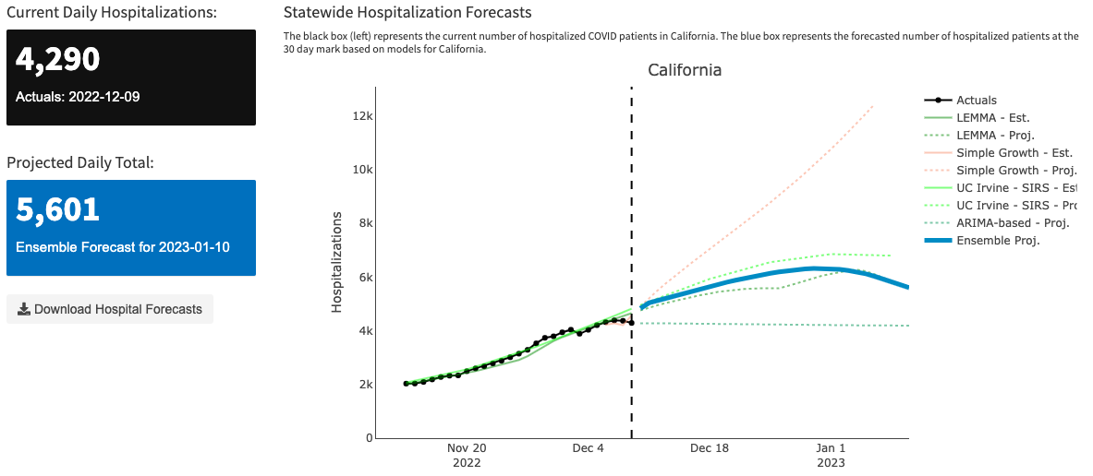
CDPH Covid-19 Modeling Forecast
https://calcat.covid19.ca.gov/cacovidmodels/

Slide 7
November Flu/Covid Vaccinations
Flu: 274
Covid: 248

Slide 8
Total Flu/Covid Vaccinations since September
As of December 6, 2022
Flu: 1111
Covid: 675

Slide 9
Bivalent Boosters Efficacy
Percentages indicate risk of symptomatic Covid.
Takeaway: This study showed that receiving a single bivalent booster significantly reduced risk of symptomatic Covid.

Slide 10
Contact Tracing
CDPH shifting toward group contact tracing
Transition of CICT Team
Aligning with similar counties

Slide 11
Testing
Testing demand (15 since Nov. 1)
Ability to Flex
Partner with Chamber of Commerce

Slide 12
Test to Treat
Open to the public
Can use home tests
Report home tests: https://primary.health/cdph/
Test-To-Treat Link: https://sesamecare.com/covid

Slide 13
Hospital Status
Green
Transferred out 4 peds
Increase RSV, Flu, Covid
Statewide shortage of pediatric beds

Slide 14
Anticipated Surge
Covid cases doubling statewide
Combination of other illness could create hospital bed shortage

Slide 15
Recent Recognition
Highest vaccination rate in region
Region includes: Alpine, Amador, Calaveras, Inyo, Mariposa, Mono & Tuolumne
Bivalent percentage:
13.6 Statewide
12.4% Mono County

Slide 16
Questions

